Slide 1
HPC Cluster 101
Tim Kellogg, Roberto Perea, Paul Colbert
IS4R – Research Computing

Slide 2
Overview
HPC cluster at a glance
How to access
Logging in
Storage & Data Transfer
Software Modules
Running & troubleshooting jobs
Cluster policies
New features
Demo!

Slide 3
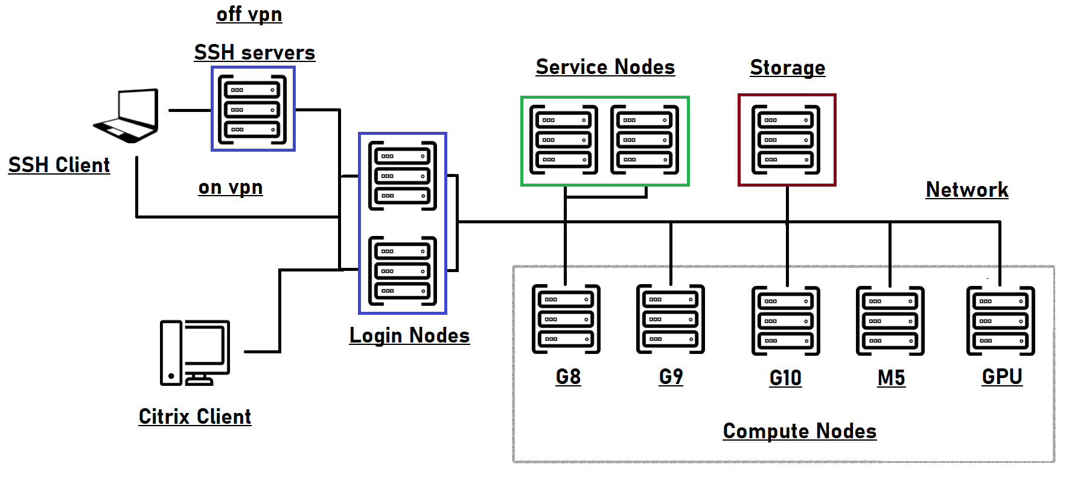
HPC Topology
ssh.research.cchmc.org
(bmisshp1/p2)
bmiisi.chmcres.cchmc.org
bmiclusterp.chmcres.cchmc.org
(bmiclusterp2/p3)
connect.research.cchmc.org
T

Slide 4
Cluster specifications
2 login nodes
2 service nodes
83 compute nodes (numbers are approx)
26 HP 460g8 with 16 cores and 256GB RAM
23 HP 460g9 with 16 cores and 256GB RAM
5 HP 460g10 with 28 cores and 256GB RAM
10 Cisco M5 with 24 cores and 256GB RAM
4 Cisco M5 with 56 cores and 768GB RAM
8 Cisco M6 with 32 cores and 512GB RAM (new)
5 Dell R740 with 2 x Nvidia V100 GPUs (16 cores, 384GB RAM)
2 Dell XE8545 with 4 x Nvidia A100 GPUs (128 cores, 512GB RAM)
10GbE interconnect
Dell/EMC Isilon storage for home, scratch, data volumes
T

Slide 5
FAQ #1: How to get access
E-mail help-cluster@bmi.cchmc.org
Accounts can typically be created within a day
You’ll get an email from us with instructions and a link to our website which has more info: https://hpc.research.cchmc.org
T

Slide 6
Logging in
Two ways: Citrix (graphical) and SSH (command line)
Login nodes – bmiclusterp2/p3
These are NOT for running jobs!
Any process consuming excessive resources will be killed
Light usage is ok: editing code, file management, etc…
Gray areas: tar, gzip, find, grep (depends on the size)
tmux and screen are your friends
FAQ #2: Why was my job killed? Ans: did you run it on the login node by mistake?
R

Slide 7
Logging in - SSH
Use your favorite ssh client
Windows: PuTTY, VSCode, Powershell?
Mac and Linux: terminal
> ssh <username>@bmiclusterp.chmcres.cchmc.org
You will land on bmiclusterp2
Off site? Use VPN or ssh gateways (ssh.research.cchmc.org)
Advanced: If you have an X server, you can turn on X forwarding with -X or -Y options
R

Slide 8
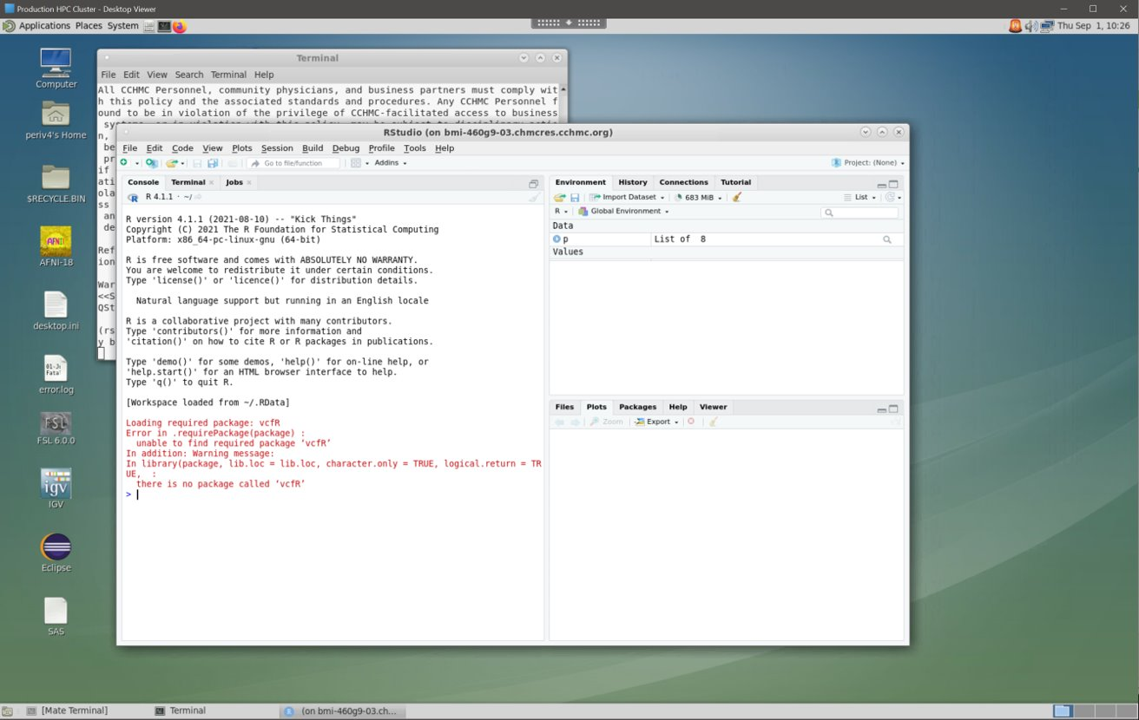
Logging in - Citrix
Point your browser to connect.research.cchmc.org and log in with CCHMC credentials
Instructions are on our website
Provides full desktop to use graphical applications (e.g. Rstudio, Matlab)
Or just a more familiar interface if you are not comfortable with CLI
You will land on either bmiclusterp2 or p3
R

Slide 9
Storage
Every user gets (free):
100GB home directory
Up to 5TB scratch directory (more on this later)
Additional storage for a fee (request via the “store”):
Additional data volumes, typically created for individual labs or groups; mounted under /data on the cluster
ritstore.research.cchmc.org
RDS6 shares can also be accessed on the cluster
rds connect <share name>
rds disconnect <share name>
rds credentials #Creates an encrypted file for passwordless use
Some reference databases & genomes can be found under /database on the cluster (module specific)
R

Slide 10
Data Transfer
Primary method: mount your home or scratch on your laptop/desktop
Almost all Isilon (bmiisi) shares are available over both NFS and SMB
Windows: \\bmiisi.chmcres.cchmc.org\home\<username>
Mac: smb://bmiisi.chmcres.cchmc.org/home/<username>
Linux: mount.cifs
Other methods
File transfer tools: scp, rsync, robocopy, WinSCP
Connect via bmiclusterp (onsite/VPN) or ssh.research.cchmc.org (offsite)
Data volumes are also mounted on ssh.research.cchmc.org, making it a good data transfer node
Sometimes data transfers can utilize excessive CPU; may need to launch an interactive job to use a compute node
R

Slide 11
Outbound access
Downloading packages or data sets from cluster is possible via proxy
Proxy access is NOT enabled by default – must request access via help-cluster ticket
FAQ #3: “I’m getting 407 error when running my script / downloading a package”
Run “proxy_on” at command line to set environment variables (e.g. http_proxy, https_proxy)
It will prompt for username and password
If your password has certain special characters it may not work – 2 options:
Change your password
Use URL encoding (e.g. %## instead of x)
We do maintain a white list of sites which are accessible without needing proxy! (Cisco Umbrella – DNS)
iswhitelisted <URL> - verify if a site is in the whitelist
R

Slide 12
Software modules
FAQ #4: "Is package xyz available on the cluster?"
module avail <pkg name>
Using installed packages
module load <pkg name>/<version>
Modifies environment variables (e.g. $PATH) to use correct binaries and libraries
module list # list all loaded packages in env
module unload <pkg name> # unload package from env
module purge # unload all packages from env
Package not listed?
We can install it for you! Request via email to help-cluster
Sometimes you can install it yourself in your home dir
However, keep in mind your home dir only has 100GB
R

Slide 13
Conda, Pip, and R
Some software has a preferred installation method
Conda
module load anaconda3
conda list
source activate <env name>
DO NOT USE conda init
Edits .bashrc which can cause issues with Citrix and other packages
Pip
each version of python has its own set of packages
Can be installed centrally by admin
R libraries
each version of R has its own set of packages
you can install your own using home dir
We maintain some (or global) environments centrally, but you can also build your own in your home dir
R

Slide 14
Submitting Jobs
job.txt
IBM LSF Scheduler
Ensures fair sharing of resources among all users
bsub #job submission command
-M <num> # memory
-n <num> # cores
-W <time> # wall time
-Is # interactive
-q <queue name>
batch example
bsub < job.txt
interactive example
bsub –W 2:00 –M 32000 –n 2 –Is /bin/bash
Queues – groups of nodes with a set of policies, users, priority
”normal” : this is default
project specific
GPU and Docker queues
#BSUB -W 2:00
#BSUB -n 2
#BSUB -M 32000
#BSUB -e <some directory>/%J.err
#BSUB -o <some directory>/%J.out
module load R
cd ~
# execute program
R CMD BATCH runme.R
R

Slide 15
Specialty jobs
GPU
Queues: gpu-v100, gpu-a100
bsub –q gpu-v100 –gpu "num=1" ...
CUDA modules available
Docker
bsub –q docker ...
Use scratch space and not /data shares
Add sticky bit to any output directory
chmod +t /scratch/<dest_dir>
R

Slide 16
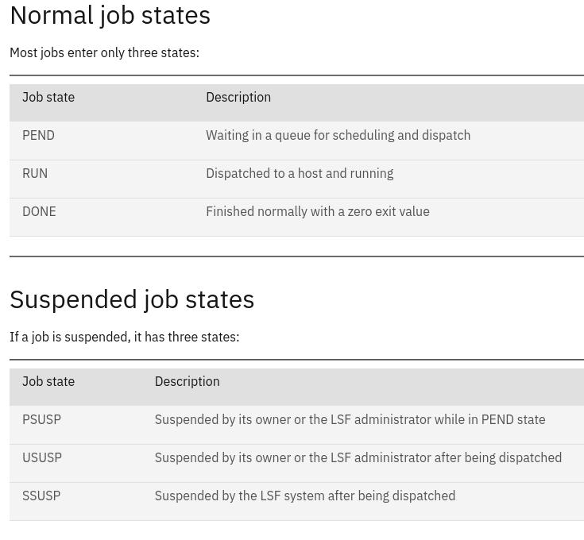
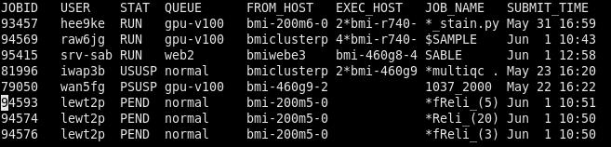
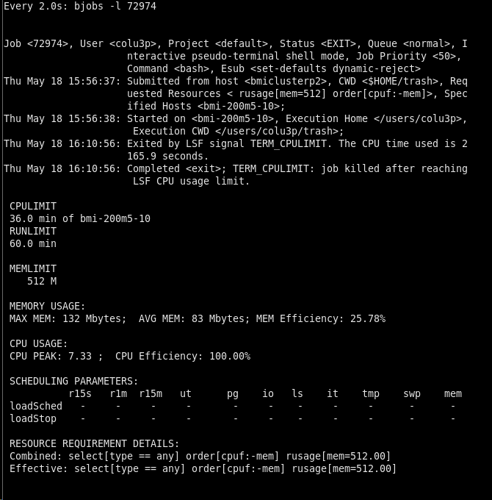
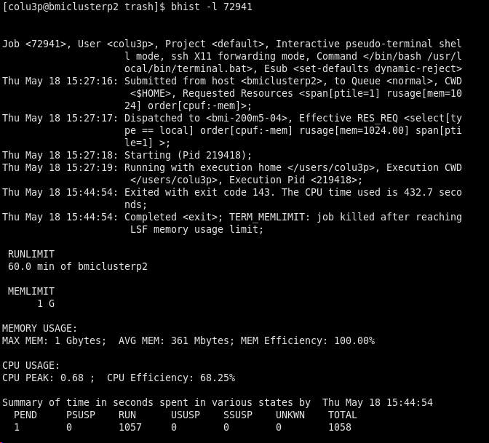
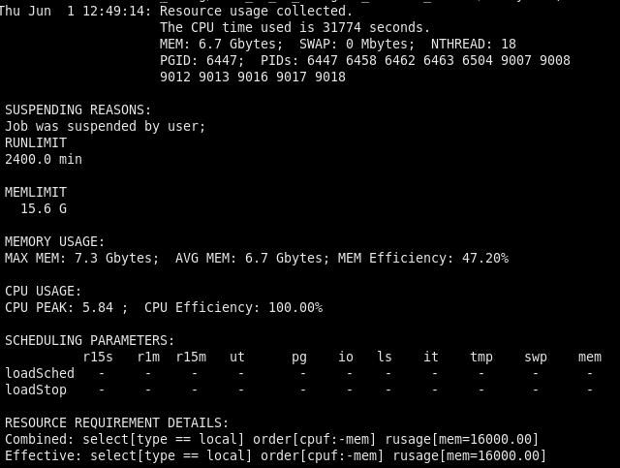
Troubleshooting jobs – bhist/bjobs
bjobs output
Exceeding CPU limit
Exceeding Memory limit
Job Suspended
P

Slide 17
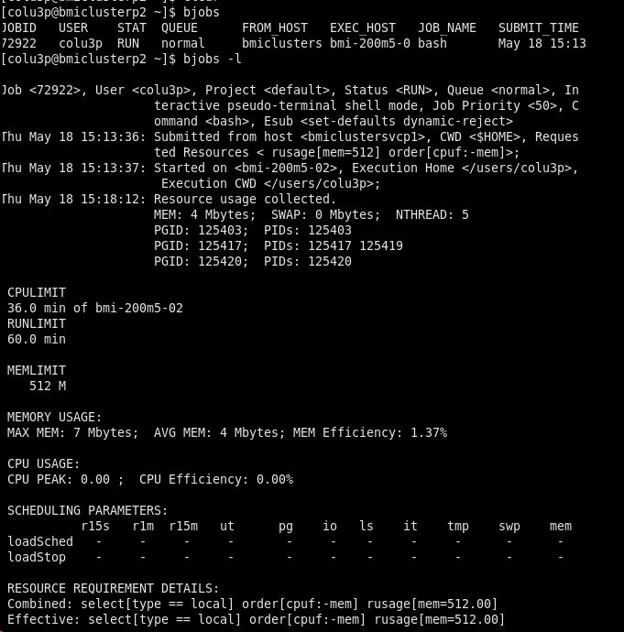
Job troubleshooting
Look at your job logs for useful info
Sometimes this is emailed to you
#BSUB options –B and –N
bjobs - Display jobs which are running or in queue
bhist - Display jobs which have completed
-u <user> Search by userID or "all" for all users
-q <queue>
-l Display in a long format
-m <host> Display jobs dispatched to a specified host
-n <#> bhist only. Number of log files to search, 0=all
bhist searches can take several minutes to run – may need compute node
bpeek - monitor stdin and stderr of a running job
-f Follow a running job
bhosts – list compute nodes’ status
P

Slide 18
Job contention
We are seeing many jobs which request much more memory than needed
Can block other jobs from running (example on next slide)
Please try to request only what you need – let’s be good HPC citizens!
P

Slide 19
Memory Example 1
Node has 512GB RAM
Job 1 is asking for 256GB RAM, is scheduled on node
Job 2 is asking for 256GB RAM, is scheduled on node
Both jobs never use more than 32GB RAM, but no other jobs can run because all memory is reserved (LSF must assume your program could use more RAM at some point)
Job 3 is asking for 128GB RAM but must wait until other jobs finish
Node – 512GB
Job 1 – 256GB
Job 2 – 256GB
Job 3 – 128 GB
PENDING
P

Slide 20
Memory Example 2
Node has 512GB RAM
Job 1 is asking for 64GB RAM, is scheduled on node
Job 2 is asking for 64GB RAM, is scheduled on node
Job 3 is asking for 128GB RAM and can be scheduled immediately since there is free RAM
Node – 512GB
Job 1 – 64GB
Job 2 – 64GB
Job 3 – 128 GB
P

Slide 21
Memory tuning
How do I know how much memory I need?!
Prior experience
Size of data set can be a good place to start
Reading a 6GB bam file – maybe start with 8GB?
There are utilities that can profile your program
LSF will tell you! (see previous slides on bjobs and bhist)
You should overestimate, but don’t go crazy!
If you program needs 16GB and you request 16GB, there’s not much room for error
If you need 16GB, requesting 24GB is reasonable
Max memory limits are ~ 17GB less than system memory
lshosts
P

Slide 22
Cluster policies
Cluster is open to all CCHMC employees
Given valid use case; you can’t mine bitcoin
External users can access as collaborators
Cluster hours
Every user is allocated 10,000 core hours each quarter
NOTE: these hours are per core and per job (ex: bsub –n 4 –W 2:00 … -> will use 8 core hours)
FAQ #5: “Where did my hours go???”
$0.01 per core hour after that, by request
FAQ #6: “Why is my job stuck in PEND/PSUSP?” (you may not have enough hours to cover the job you are trying to submit)
Watch your “reserved” hours
Check your balance: module load gold then gbalance –h
Job/User limits:
754GB max RAM per job
3.57TB max RAM per user
125 max running jobs/cores per user (can be increased on request)
1250 max pending jobs per user (can be increased on request)
P

Slide 23
Cluster policies
Scratch storage - /scratch/<youruserid>
Designed to be a workspace for your jobs
Ideal for docker jobs
Permissions are UNIX based vs DP based for /data shares
Baseline limit of 100GB, with a 7 day burst limit of 5TB
Check limits with `scratchusage`
$ scratchusage
Scratch Usage: 73GB Hard Limit: 5120GB
100GB Base quota is not currently in violation.
P

Slide 24
Cluster maintenance
When: every 90 days
Why: To ensure the latest security and stable releases on the OS are installed
Impact: Citrix and ssh sessions will be disconnected, including interactive jobs, rstudio and matlab programs
An email will be sent a week prior, with up to 3 reminders
It is advisable to plan and save your work during the outage
P

Slide 25
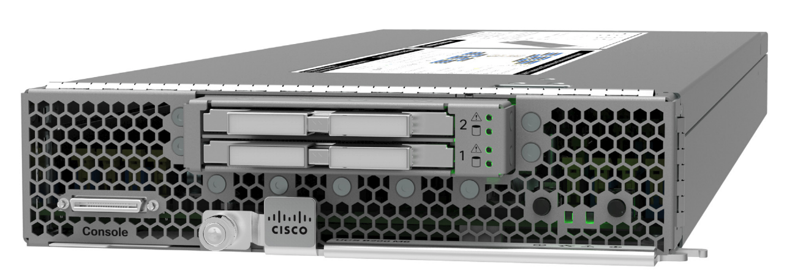
New HPC nodes
Intel Xeon Gold 6326 – 2.9 Ghz, 16 cores
Cisco M6 blade – two CPUs, 512GB RAM
T

Slide 26
Per user job limits increased
Default max of 125 cores per user (up from 100)
Will increase to 150 if monitoring looks ok
Reminder on how cores are counted:
bsub –n 8 #asking for 8 cores
If I run 4 of these jobs, I’m using 32 out of 125 max cores
T

Slide 27
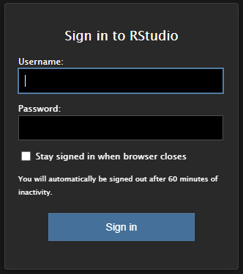
Rstudio in the browser
Run this command in an interactive session:
/usr/local/bin/rserver.sh
From your CITRIX session
Open a Firefox/Chromium page on the CITRIX server and point to:
http://bmi-460g8-01.chmcres.cchmc.org:33592
or
From your workstation
ssh -L 8787:bmi-460g8-01.chmcres.cchmc.org:33592 root@bmiclusterp.chmcres.cchmc.org -p 22
Open a Firefox/Chromium page and point to:
http://localhost:8787
T

Slide 28
Jupyter Notebook
$ module load anaconda3
$ source activate myenv
$ jupyter-notebook --ip=0.0.0.0 --port=8888 --no-browser
[I 15:12:12.423 NotebookApp] Loading IPython parallel extension
[I 15:12:13.967 NotebookApp] JupyterLab extension loaded from /usr/local/anaconda3-2020/lib/python3.8/site-packages/jupyterlab
[I 15:12:13.968 NotebookApp] JupyterLab application directory is /usr/local/anaconda3-2020/share/jupyter/lab
[I 15:12:13.972 NotebookApp] Use Control-C to stop this server and shut down all kernels (twice to skip confirmation).
[C 15:12:13.990 NotebookApp]
To access the notebook, open this file in a browser:
file:///users/periv4/.local/share/jupyter/runtime/nbserver-24375-open.html
Or copy and paste one of these URLs:
http://bmi-460g8-01.chmcres.cchmc.org:8888/?token=7f33467e41fba92d6adde3789b4bdbe7b44f06c22a042b27
T

